Slide 1
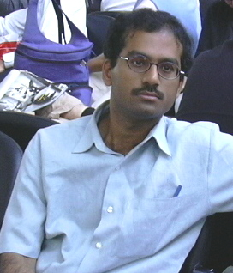
Dr. M. S. Santhanam (IISER Pune)
Research Interests :
Nonlinear dynamics, chaos and quantum chaos
Complex systems and statistical physics
Time series analysis
Scientific computing / Computational physics
Digital watermarking
More info click here

