Slide 1
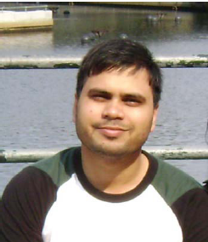
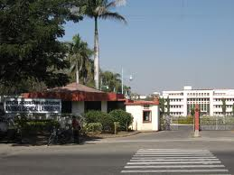
About our Speaker
Name: Ravi P. Singh
Where does s(he) work: Organic Chemistry Division, National Chemical Laboratory, Dr. Homi Bhabha Road, Pune-411008
What does s(he) do: Senior Scientist & Assistant Professor (AcSIR, Chemical Sciences).
Make and break C-C bonds.
Design and synthesis of medicinally important molecules, Teaching Ph.D. students.
Insert your passport/profile picture here
Insert a picture of your lab/institute or a logo
Where and what did s(he) study: M.Sc. –Organic chemistry (Banaras Hindu University, Varanasi), Ph.D.-Chemistry (IIT-Kanpur), Postdoctoral Fellow ( with Prof. E. J. Corey, Nobel laureate, Harvard University, Cambridge, MA, USA) Postdoctoral Fellow ( with Prof. Li Deng, Brandeis University, Waltham, MA, USA)
What are your interests (in your job, and outside):
Write poetry
Travel and explore
Ignite interest in school children for science and technology

