Slide 1
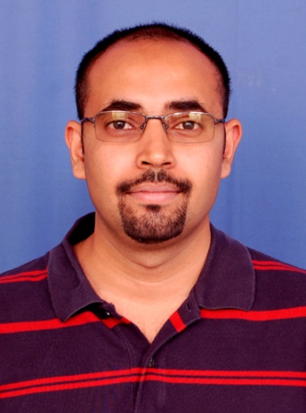
About our Speaker
Name: G. V. Pavan Kumar
Where does he) work: Indian Institute of Science Education and Research, Pune
What does he do: Assistant Professor. I am a scientist interested in understanding light and its interaction with matter at micro and nanoscale
Where and what did he study:
M.Sc (Physics) – Bangalore University
Ph.D. (Laser spectroscopy) – Jawaharlal Nehru Centre for Advanced Scientific Research, Bangalore
Post-doctoral researcher at Institute of Photonic Sciences, Barcelona (Spain) and Discovery Park, Purdue University (USA)
What are your interests (in your job, and outside):
Research interest: Photonics, Raman scattering
Other interest: Writing (non-fiction)

