Slide 1
Energizing the Earth
K. Krishnamoorthy
Polymers and Advanced Materials Laboratory
National Chemical Laboratory-Pune

Slide 2
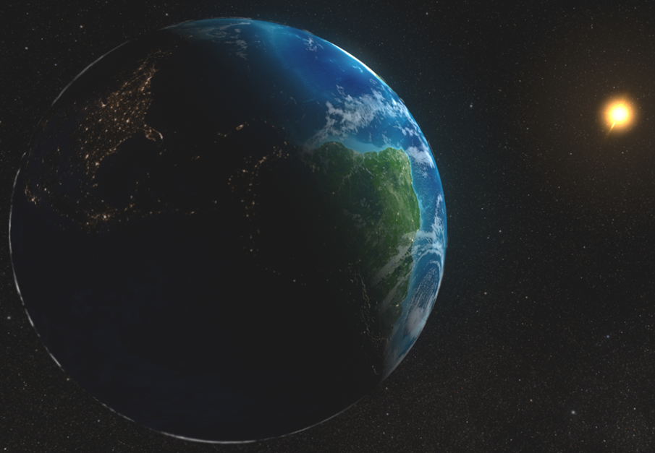

Slide 3
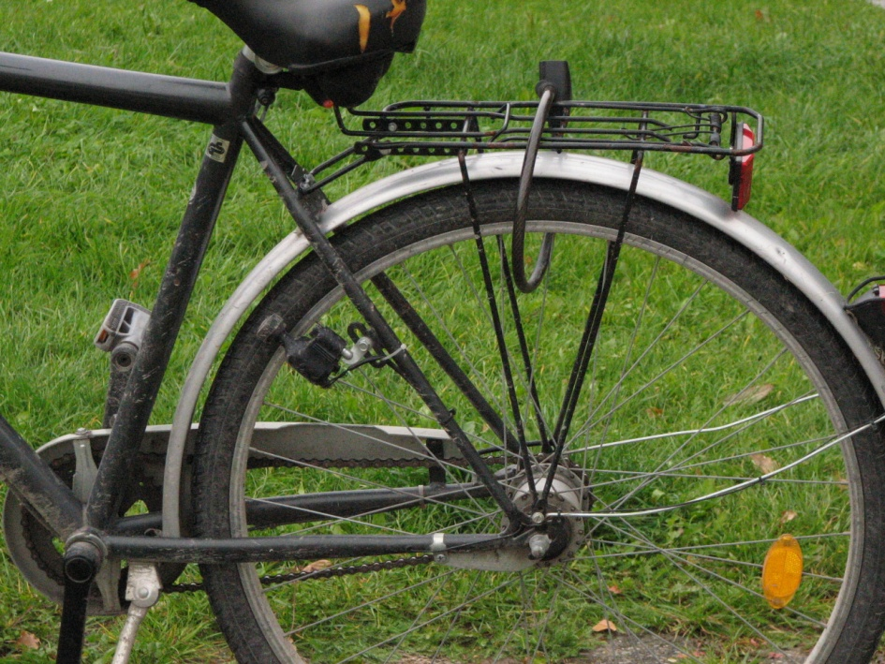
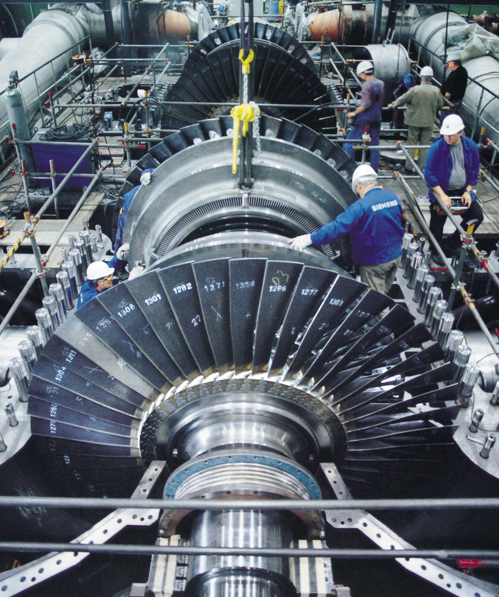
Source of Electricity
Electromagnetic induction, where an electrical generator, dynamo or alternator converts kinetic energy into electricity
Coal | 75%
Hydroelectric | 20%
Nuclear | 4%
Water is boiled by nuclear fission, burning of fossil fuel (coal)

Slide 4
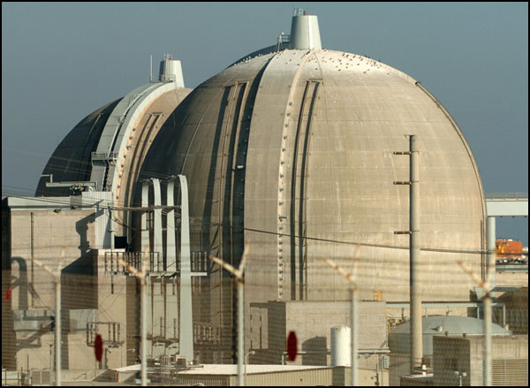
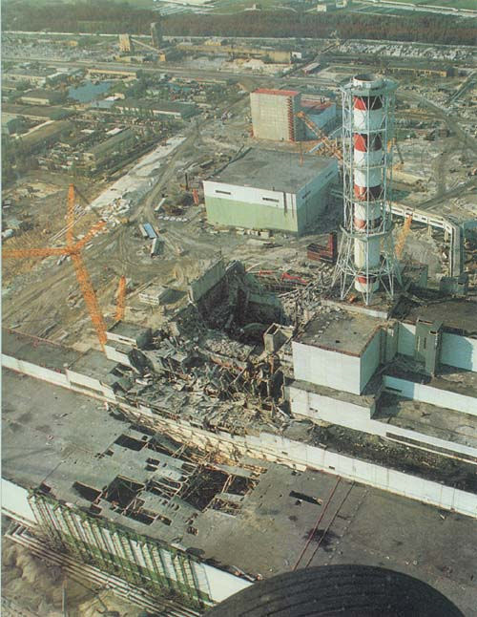
Nuclear Energy
Nuclear power plants are as safe as candy factories!
Build 1 nuclear plant per day
17 Nuclear power plants generates 4% electricity
India’s Uranium reserve is 70000 tons, too little! Quality of the ore is also poor. Imports from France, Russia and Namibia.

Slide 5
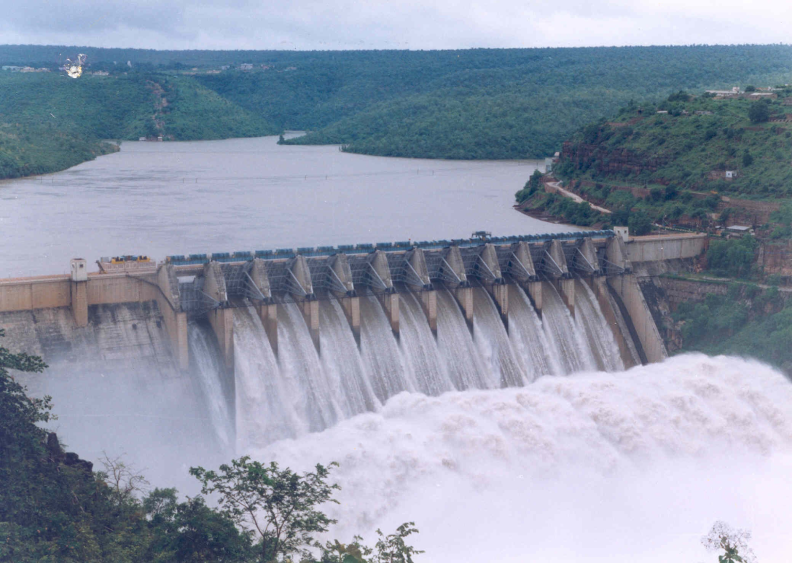
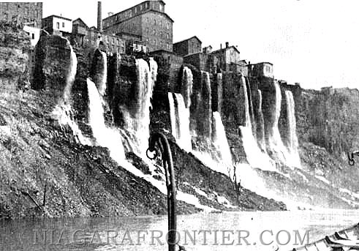
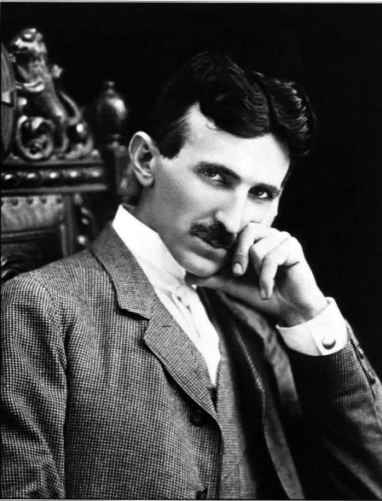
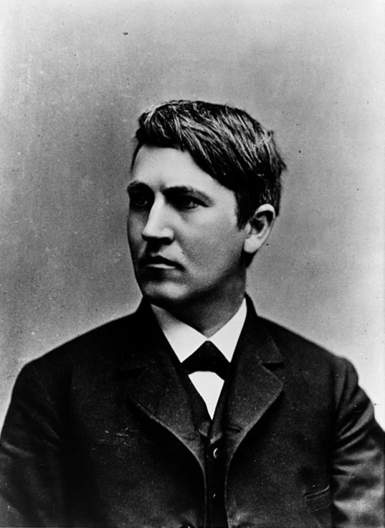
Hydroelectric Energy
War of Currents
25 major hydroelectric power plants
No direct waste
Low greenhouse gas emission
Monsoon?

Slide 6
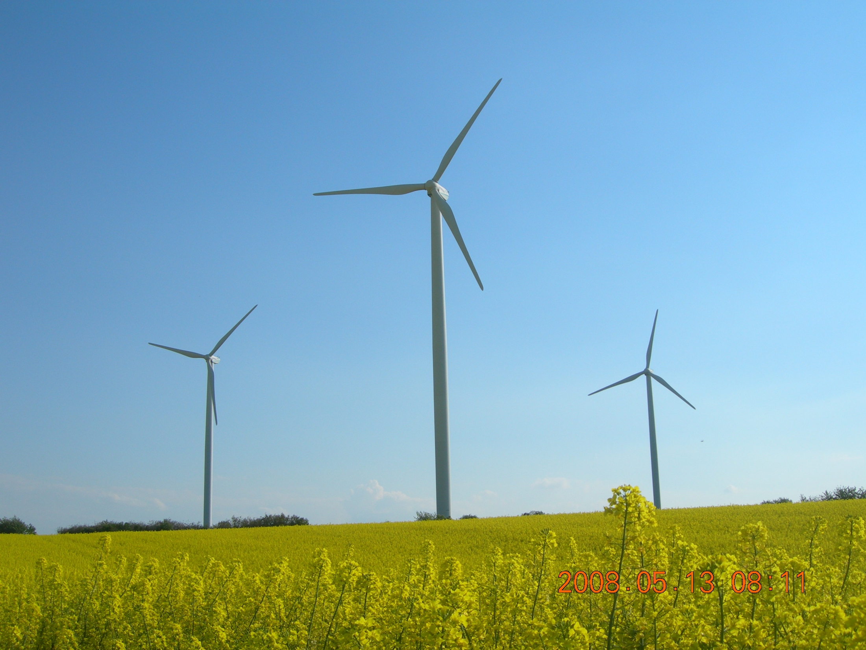

Slide 7
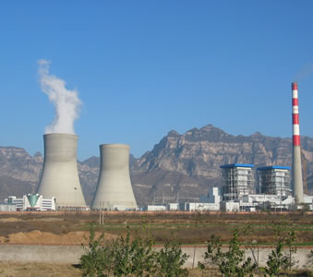
Thermal Power Stations
India has the world’s second largest coal reserve
India is the third largest coal producer
India imports coal from Indonesia, Australia and South Africa
India exports coal to Bangladesh, Nepal and Bhutan
23 Thermal power plants ~ 75% of India’s electricity needs!
Coal is burnt to boil water that drives the turbine
http://www.youtube.com/watch?v=e_CcrgKLyzc&feature=relmfu

Slide 8
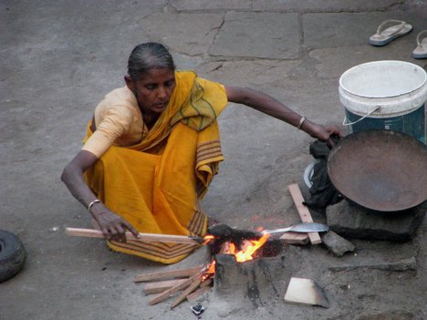
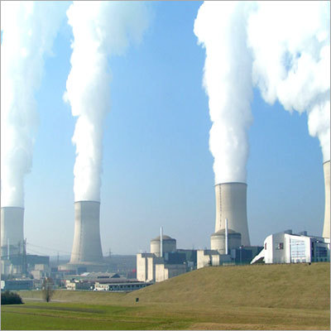
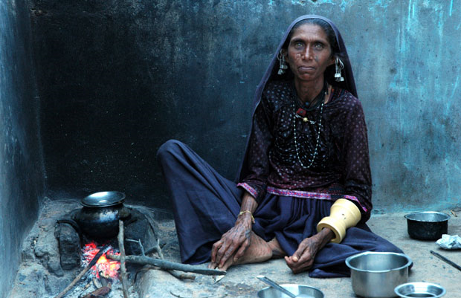
Thermal Power Stations
Close to 50% of global population rely on
solid fuel (wood, charcoal and coal)
Respiratory diseases due to choking smoke
1.6 million casualties (mostly women and children)

Slide 10
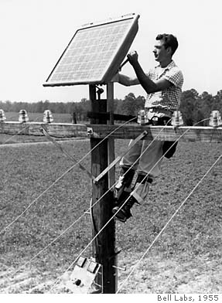
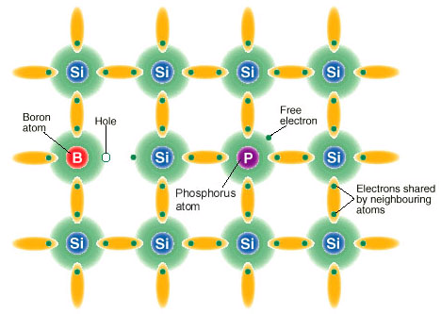
Solar Energy
Si 1S² 2S² 2P⁶ 3S² 3P²
P 1S² 2S² 2P⁶ 3S² 3P³
B 1S² 2S² 2P¹
n type conductor
p type conductor
p
n

Slide 11
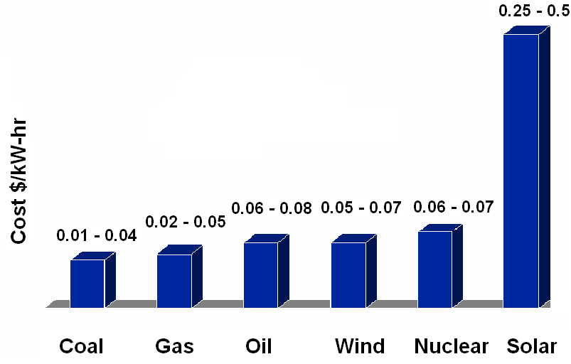
Solar Energy
Silicon is abundantly available
Obtaining doped silicon is non trivial
It requires high temperature processing (above 1000° C)
Overall the technology is not commercially viable

Slide 12
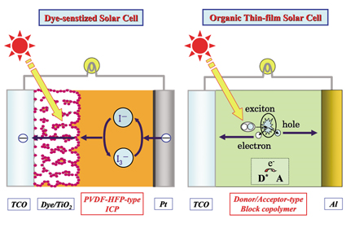
Dye Sensitised and Organic Solar Cells

Slide 13
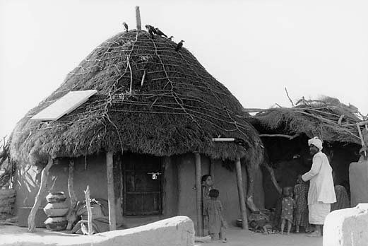
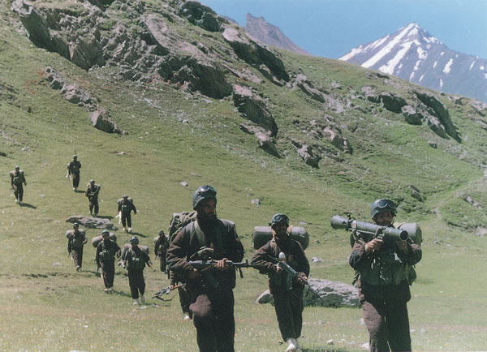
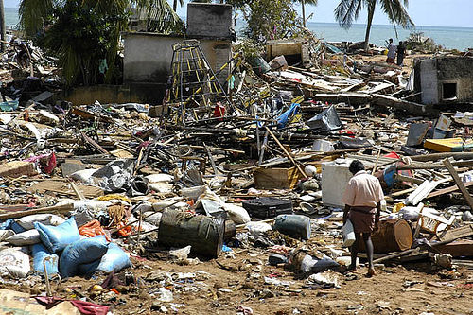
Advantages
30% loss in grid based electricity
India soldier carries 30 kg of arms and ammunitions
Use in remote locations

Slide 14
“I’d put my money on the sun and solar energy. What a source of power! I hope we don’t have to wait till oil and coal run out before we tackle that.”
- Thomas Edison (1847-1931)
“If someone tomorrow found the technology, the game changer, and it was really possible to bring it to market within three years, at scale, then I surmise we would change our whole business, our whole investment process, to support that game changer.” Steve Westwell
BP Vice President, Renewables
Can one of you be the game changer?

Slide 15
Thank You

